Slide 1

Video Games Data Analysis
Cairo University
Faculty of Engineering
Prepared by Team 18
Supervised by
Prof. Dina Elreedy
Eng. Mohamed Abduallah

Slide 2
Agenda
1
2
3
Problem Definition
Motivation
Data Preprocessing
4
5
6
Data Exploration
Analysis
Conclusion

Slide 3
Problem Definition

Slide 4
Problem Definition
Analyze global video game sales across genres.
Predict future sales, with visualizations to aid understanding and communication.
Provide actionable insights.
Better position companies in the market and maximize revenue potential.
Notes:
Problem: Analyze global video game sales across genres to identify consumer behavior trends and inform business decisions.
Data: Sales data on genre, platform, publisher, developer, year of release, ratings, and region of sale.
Analysis: Statistical models and machine learning algorithms to predict future sales, with visualizations to aid understanding and communication.
Objective: Provide actionable insights to inform marketing, product development, and distribution strategies for video game companies.
Benefit: Better position companies in the market and maximize revenue potential through understanding of consumer behavior and trends.

Slide 5
Motivation

Slide 6
Motivation
Uncover insights to help video game businesses stay ahead of competition and succeed in a crowded market.
Take Business decisions.
Stay on the cutting edge of innovation and adapt to changing market conditions through analysis of emerging trends.

Slide 7
Data Preprocessing

Slide 8
Data Preprocessing
Detecting & Dealing with Outliers
Handling Missing Values
Encoding Categorical Features

Slide 9
Data Exploration

Slide 10
Data Exploration
Discrete:
Name
Developer
Publisher
Platform
Genre
Rating: 4 main categories are E (everyone),M(mature +17), T(teenagers) and E10+ (everyone +10).

Slide 11
Data Exploration
Continuous:
Year_of_Release
NA_Sales: North America Sales
EU_Sales: Europe Sales
JP_Sales: Japan Sales
Other_Sales
Global_Sales
Critic_Score: Aggregate score compiled by Metacritic staff.
Critic_Count: The number of critics used in coming up with the Critic_score.
User_Score: Score by Metacritic's subscribers
User_Count: Number of users who gave the user_score

Slide 12
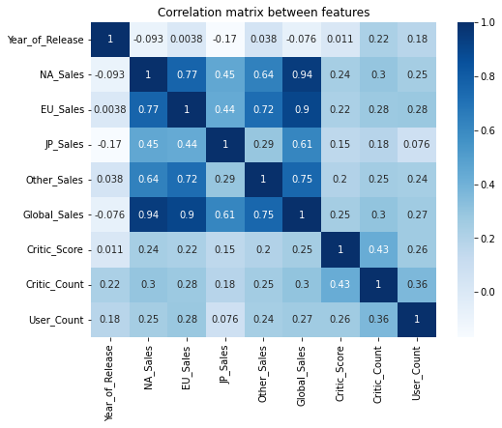
Data Exploration
Notes:
Sales columns only have a very high corr coefficient which indicates that high sales of a game in certain regions means high sales in others.

Slide 13
Business Decisions

Slide 14
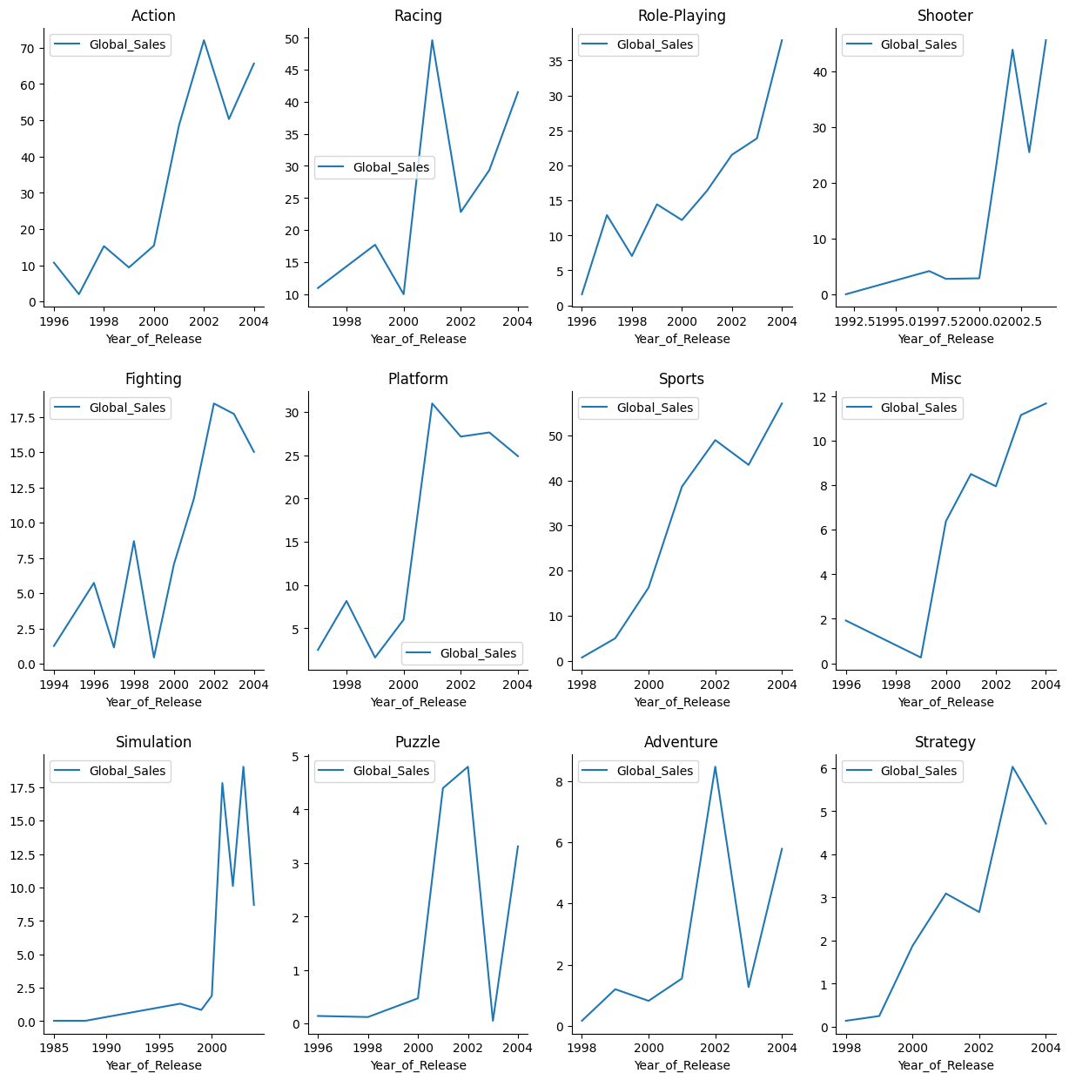
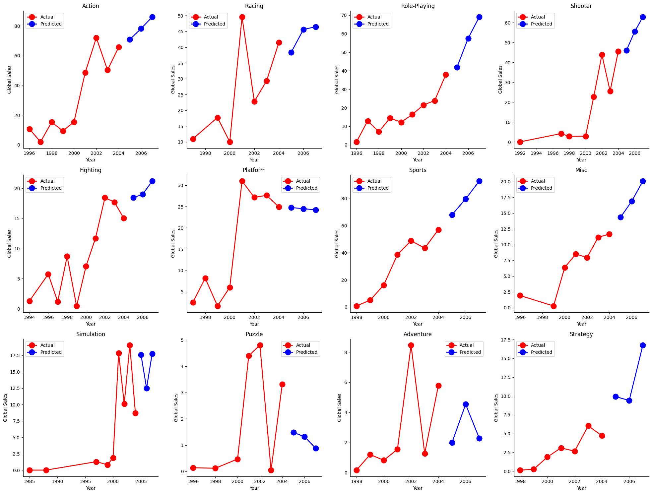
Which Genres will have more sales in the future? P2

Slide 15
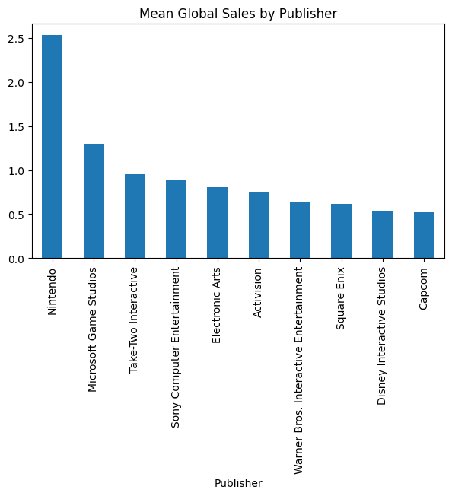
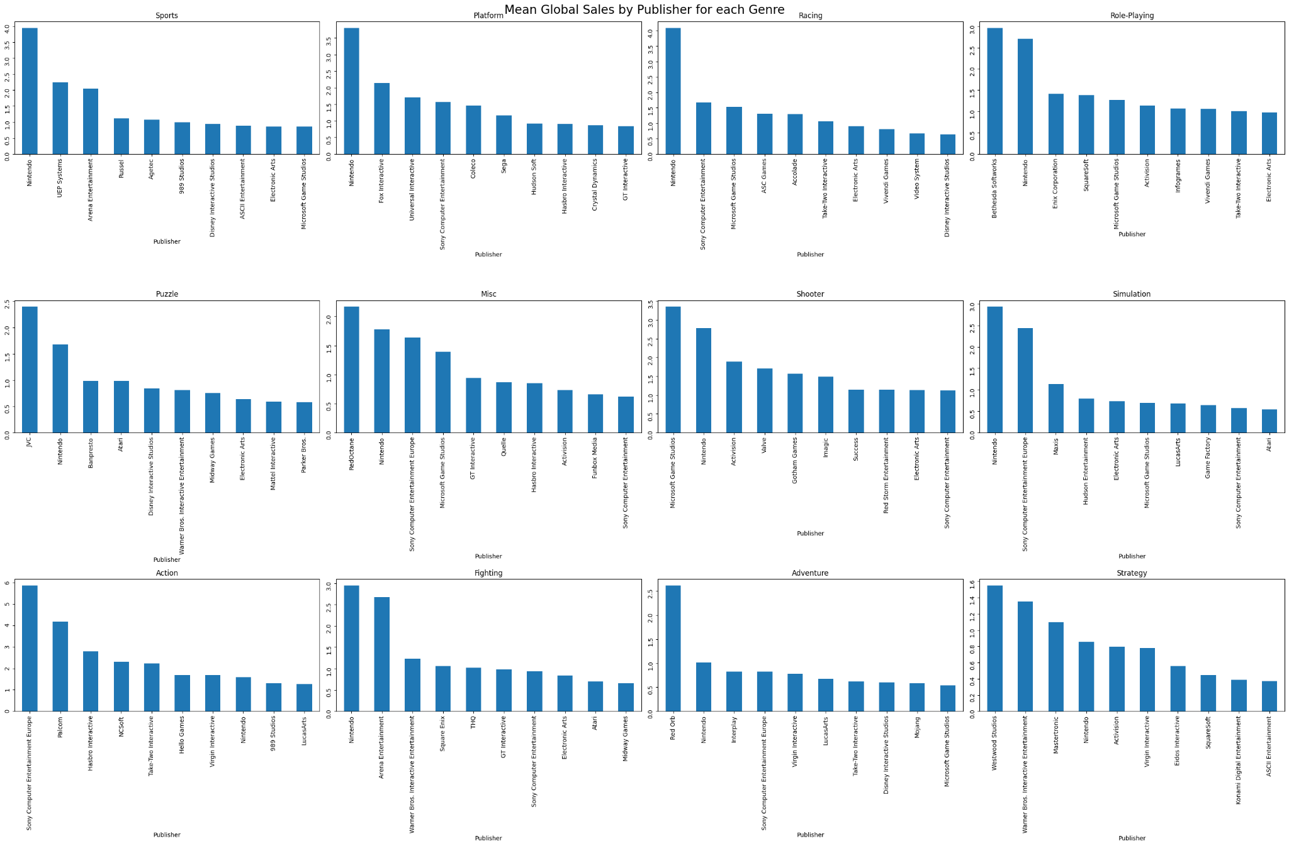
Which Publishers to deal with? E2

Slide 16
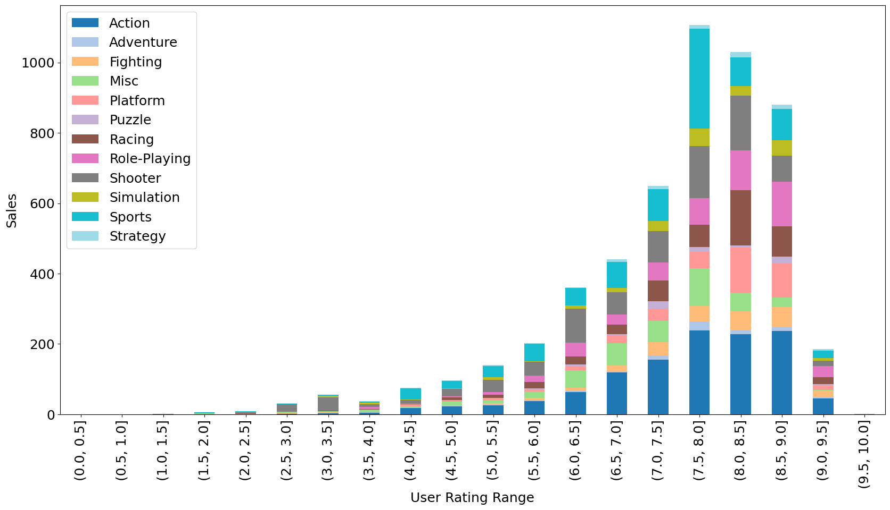
Which Genres to focus on? (D1)
Notes:
Akram
Descritpive Q1
For games rated more than X, what is the most popular genre ?
Rating groups - each rating bin: genres sized by sum of global sales

Slide 17
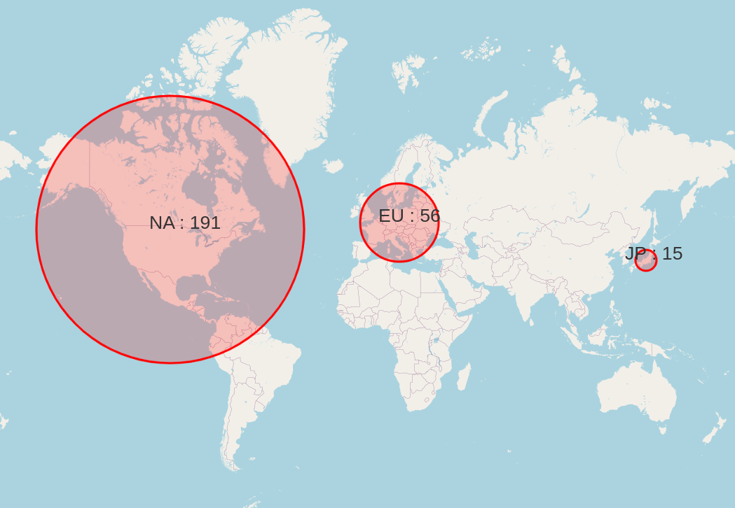
Which Regions to focus on? (E6)
Notes:
Akram
Exploratory Q6
Is there a certain publisher whose sales are most coming from a certain region?
For each region: count the number of publishers that have their maximum sales in that region

Slide 18
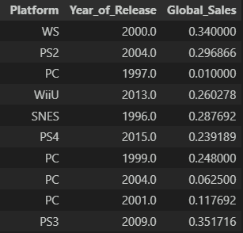
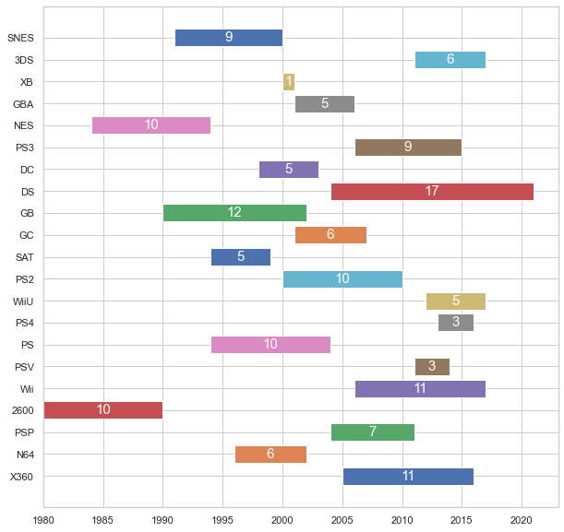
Compare platforms based on how long they stay competitive in the market. E3
Notes:
Akram
Exploratory Q6
Is there a certain publisher whose sales are most coming from a certain region?
For each region: count the number of publishers that have their maximum sales in that region

Slide 19
Compare platforms based on how long they stay competitive in the market. E3
Dataset is limited by the time slot it captured:
some platforms were active from before the very first game in this dataset
some platforms kept active after
some platforms didn’t have enough games to showcase every single year of every single platform
Notes:
Akram
Exploratory Q6
Is there a certain publisher whose sales are most coming from a certain region?
For each region: count the number of publishers that have their maximum sales in that region

Slide 20
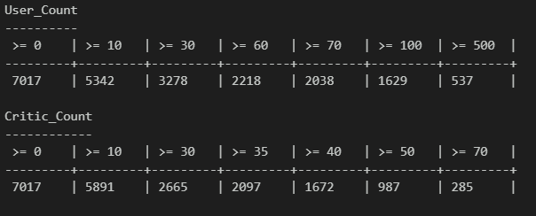
Do users/critics rate a specific platform or genre higher than others? E4
Is actually 4 questions disguised as one
Notes:
Akram
Exploratory Q6
Is there a certain publisher whose sales are most coming from a certain region?
For each region: count the number of publishers that have their maximum sales in that region

Slide 21
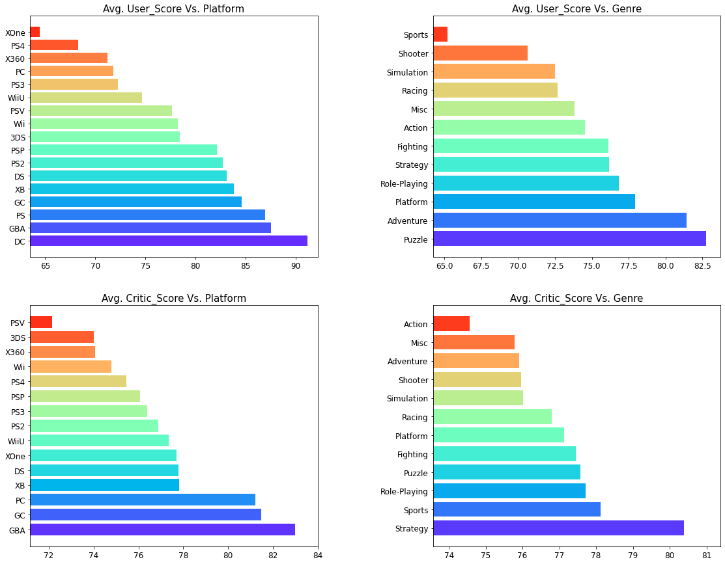
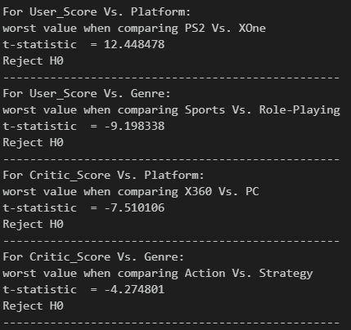
Notes:
Akram
Exploratory Q6
Is there a certain publisher whose sales are most coming from a certain region?
For each region: count the number of publishers that have their maximum sales in that region

Slide 22
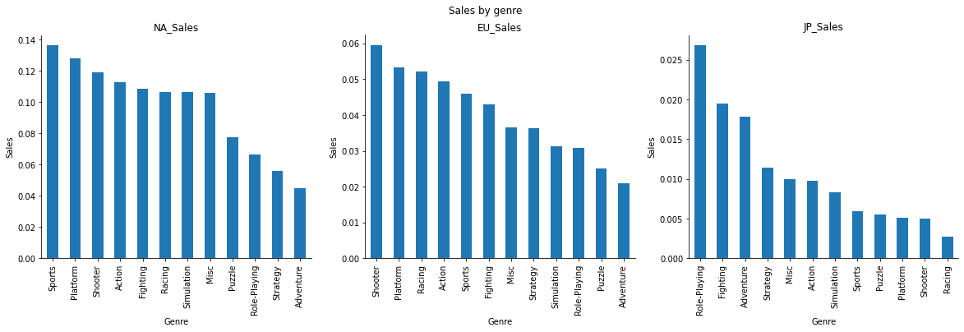
Which game genre to publish and in which region? E5

Slide 23
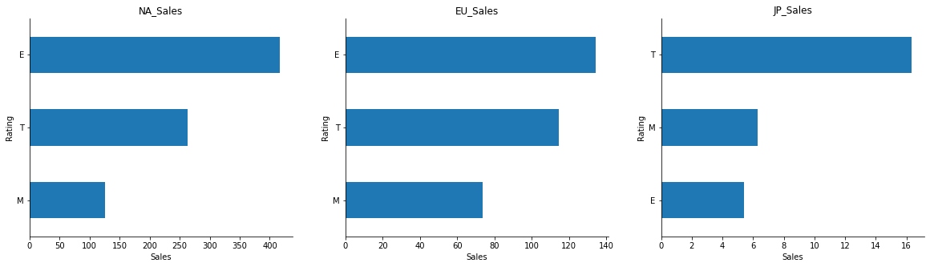
Which game genre to publish and in which region? E5

Slide 24
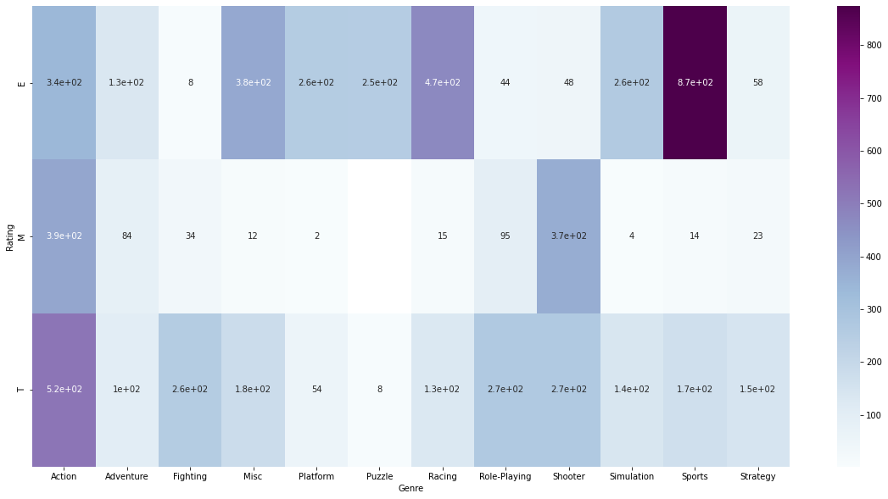
Which game genre to publish and in which region? E5
Notes:
The ESRB rating may play a role in influencing the sales of video games.
In North America, the Sports genre with an E rating dominates the market and generates the highest sales.
In Europe, games rated for Everyone and Teenagers are the most popular, with the Shooter genre being the most common with a T rating, and generating the highest sales. This trend in Europe suggests a preference for games with violent elements that may not be suitable for children.
In Japan, games rated for Teenagers are the most popular, with the Role-Playing genre being the most common with a T rating and generating the highest sales.

Slide 25
Business Benefits

Slide 26
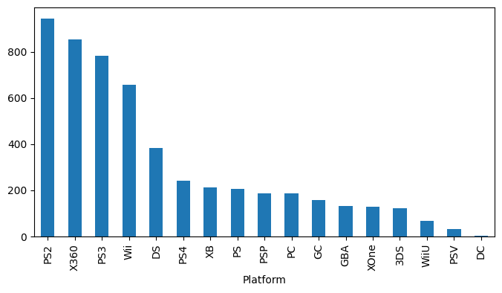
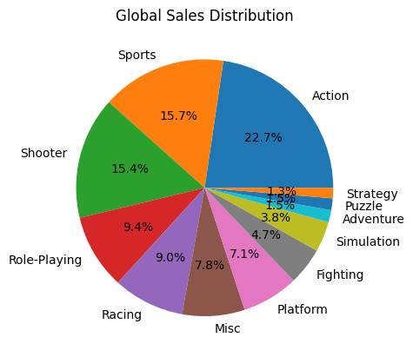
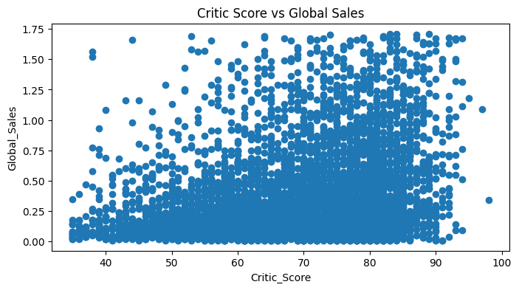
Predict Global Sales of a new game
Effective Features:

Slide 27
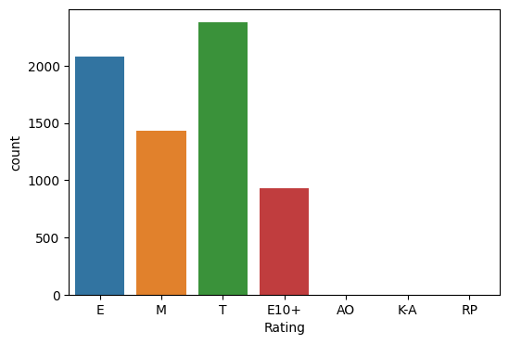
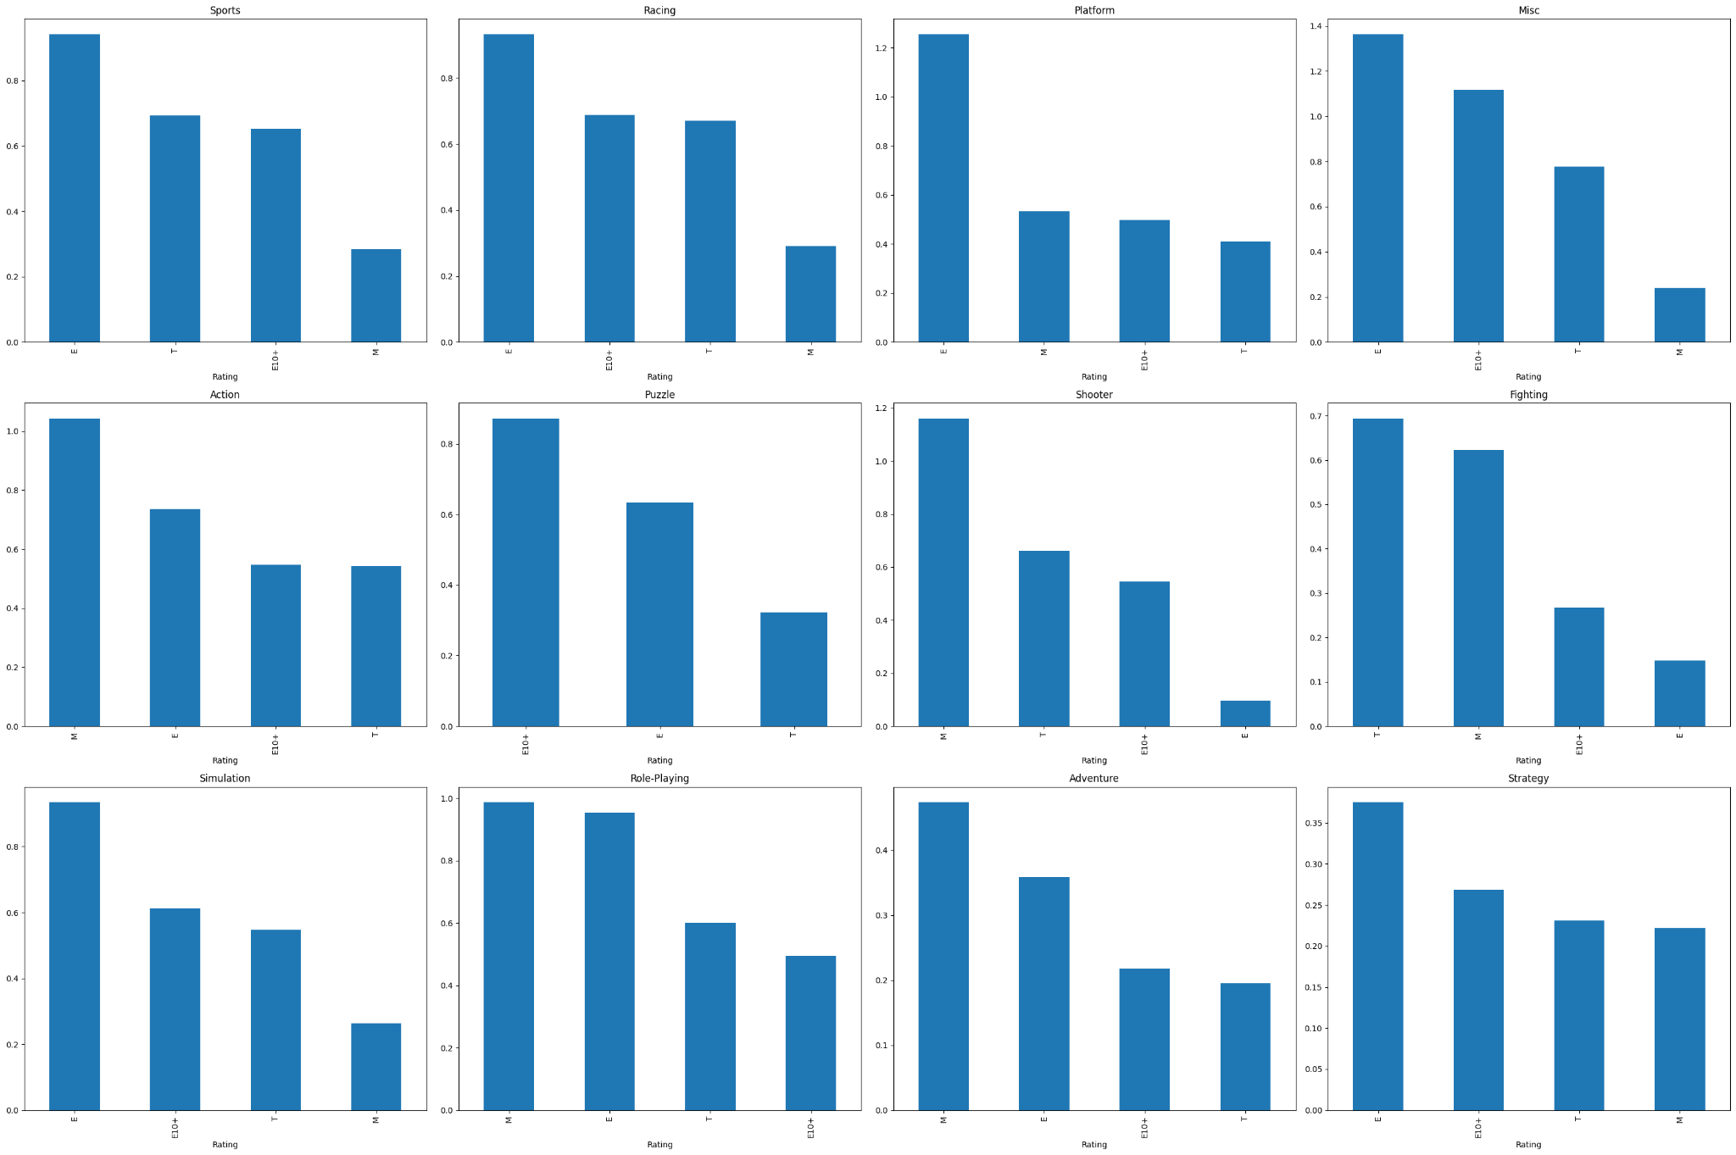
Predict Class Rating of a game

Slide 28
Thank you!

